Slide 1
Game playing
Chapter 5

Slide 2
Outline
Games
Perfect play
minimax decisions
α-β pruning
Resource limits and approximate evaluation
Monte Carlo Tree Search
Games of chance
Games of imperfect information

Slide 3
Games vs. search problems
“Unpredictable” opponent ⇒ solution is a strategy specifying a move for every possible opponent reply
Time limits ⇒ unlikely to find goal, must approximate
Plan of attack:
Computer considers possible lines of play (Babbage, 1846)
Algorithm for perfect play (Zermelo, 1912; Von Neumann, 1944)
Finite horizon, approximate evaluation (Zuse, 1945; Wiener, 1948; Shannon, 1950)
First chess program (on paper) (Turing, 1951)
Machine learning to improve evaluation accuracy (Samuel, 1952-57)
Pruning to allow deeper search (McCarthy, 1956)

Slide 4
Types of games
deterministic chance
Perfect information
Imperfect information
Chess, Checkers, Go, Othello | Backgammon Monopoly
Battleship, Blind tictactoe | Bridge, Poker, Scrabble

Slide 5
Game tree (2-player, deterministic, turns)
MAX (X)
X
X | O
X | O |  | X
 | X
 |  | X
X
 |  | X
X
 | X
 |  | X
MIN (O)
X
X |  | O
X
O
. . .
MAX (X)
X | O
X
X | O
 | X
. . .
MIN (O)
. . .
. . .
. . .
. . .
X | O |  | X
 | O |  | X
 | O
X | O |  | X
O | O |  | X
X | X |  | O
X | O |  | X
 | X
X | O |  | O
. . .
TERMINAL
Utility
−1
0
+1

Slide 6
Minimax
Perfect play for deterministic, perfect-information games
Idea: choose move to position with highest minimax value = best achievable payoff against best play
E.g., 2-ply game:
MAX
3
A ₁
A ₂
A ₃
MIN
3
2
2
^{A} 11 ^{A} 12 ^{A} 13
^{A} 21 ^{A} 22
^{A} 23
^{A} 31 ^{A} 32 ^{A} 33
3
12 8 2 4 6 14 5
2

Slide 7
Minimax algorithm
function MINIMAX-DECISION(state) returns an action
inputs: state, current state in game
return the a in ACTIONS(state) maximizing MIN-VALUE(RESULT(a, state))
function MAX-VALUE(state) returns a utility value
if TERMINAL-TEST(state) then return UTILITY(state)
v ← −∞
for a, s in SUCCESSORS(state) do v ← MAX(v, MIN-VALUE(s))
return v
function MIN-VALUE(state) returns a utility value
if TERMINAL-TEST(state) then return UTILITY(state)
v ← ∞
for a, s in SUCCESSORS(state) do v ← MIN(v, MAX-VALUE(s))
return v

Slide 8
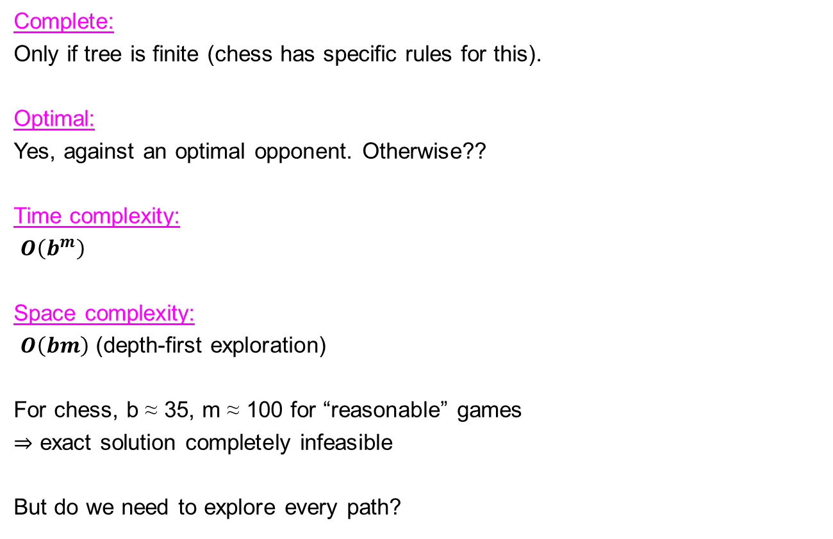
Properties of minimax
Complete:
Only if tree is finite (chess has specific rules for this).
Optimal:
Yes, against an optimal opponent. Otherwise??
Time complexity:
$O\left(b^{m}\right)$
Space complexity:
$O\left(bm\right)$(depth-first exploration)
For chess, b ≈ 35, m ≈ 100 for “reasonable” games
⇒ exact solution completely infeasible
But do we need to explore every path?

Slide 9
α-β pruning example
MAX
≥3
3
3
≤2
≤14
≤5
2
MIN
X X
3
12
8
2
14
5
2

Slide 10
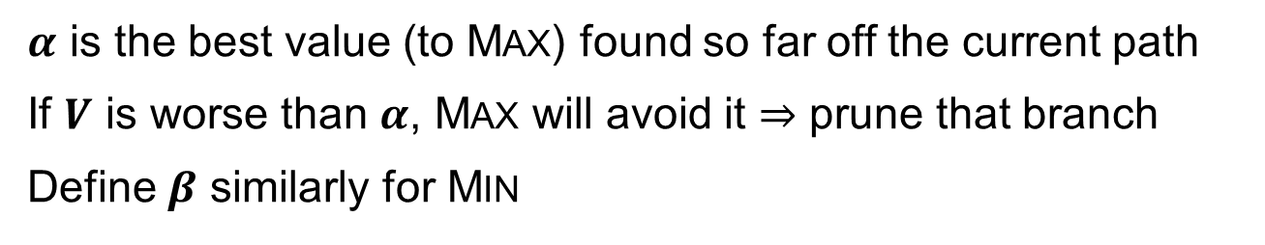
Why is it called α-β?
MAX
≥α
MIN
..
..
..
MAX
α
≥α
MIN
≤V
V
$α$ is the best value (to MAX) found so far off the current path
If $V$ is worse than $α$, MAX will avoid it ⇒ prune that branch
Define $β$ similarly for MIN

Slide 11
The α-β algorithm
function ALPHA-BETA-DECISION(state) returns an action
v ← MAX-VALUE(state, −∞, +∞)
return the action in ACTIONS(state) with value v
function MAX-VALUE(state, α, β) returns a utility value
inputs: state, current state in game
α, the value of the best alternative for max along the path to state
β, the value of the best alternative for max along the path to state
if TERMINAL-TEST(state) then return UTILITY(state)
v ← −∞
for a, s in SUCCESSORS(state) do
v ← MAX(v, MIN-VALUE(s, α, β))
if v ≥ β then return v
α ← MAX(α, v)
return v
function MIN-VALUE(state, α, β) returns a utility value
same as MAX-VALUE but with roles of α, β reversed

Slide 12
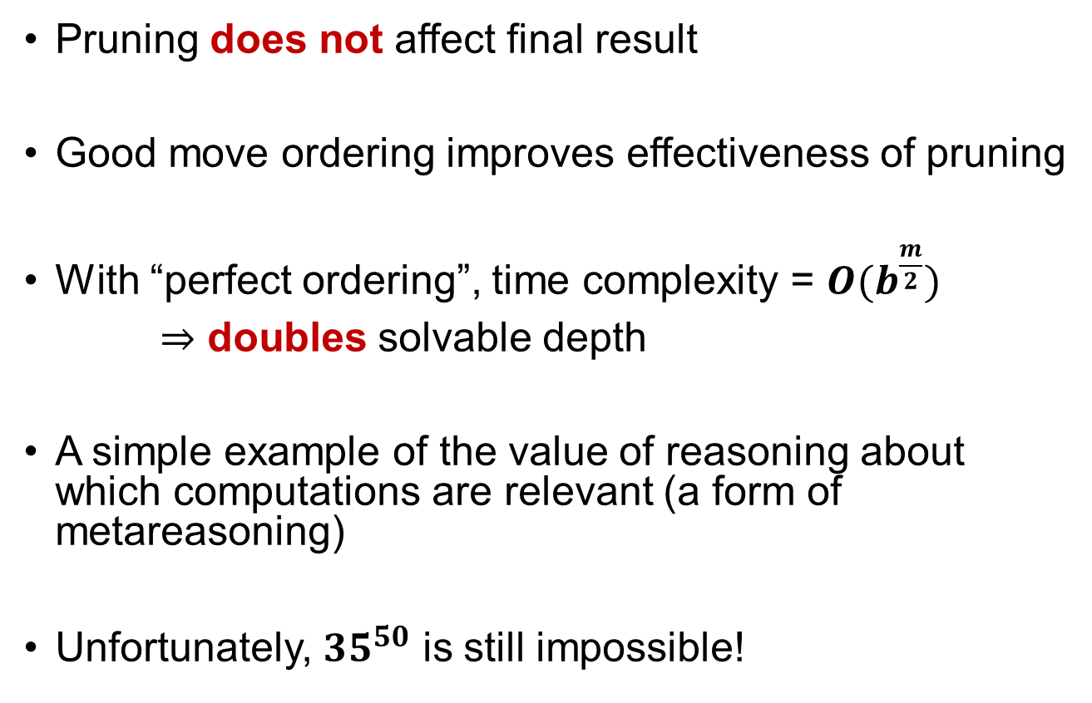
Properties of α-β
Pruning does not affect final result
Good move ordering improves effectiveness of pruning
With “perfect ordering”, time complexity = $O(b^{\frac{m}{2}})$
⇒ doubles solvable depth
A simple example of the value of reasoning about which computations are relevant (a form of metareasoning)
Unfortunately, $35^{50}$ is still impossible!

Slide 13
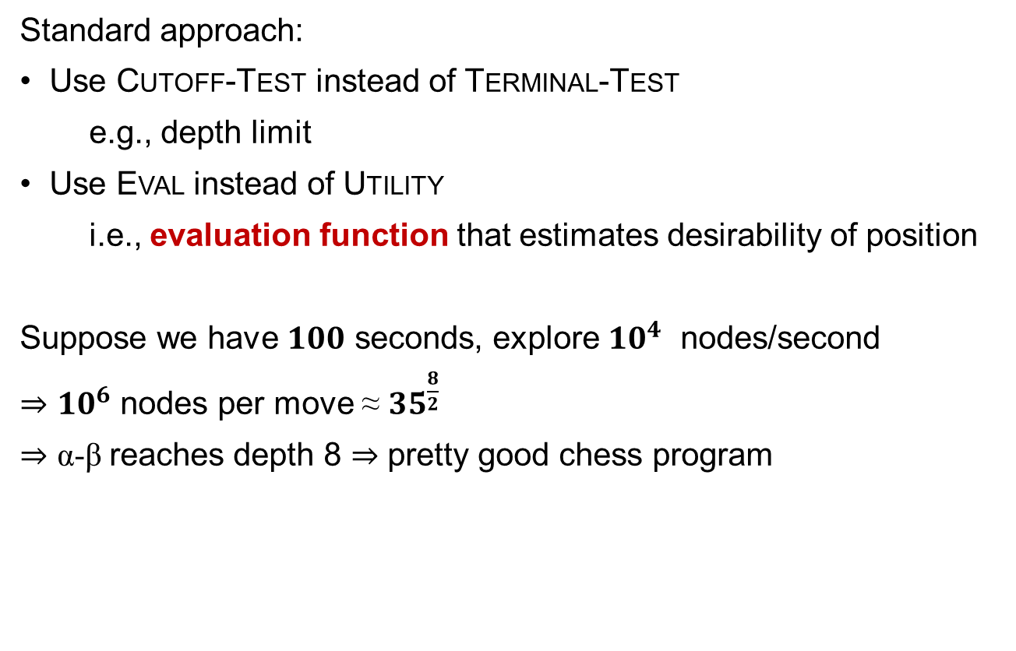
Resource limits
Standard approach:
Use CUTOFF-TEST instead of TERMINAL-TEST
e.g., depth limit
Use EVAL instead of UTILITY
i.e., evaluation function that estimates desirability of position
Suppose we have $100$ seconds, explore $10^{4}$ nodes/second
⇒ ${10}^{6}$ nodes per move ≈ $35^{\frac{8}{2}}$
⇒ α-β reaches depth 8 ⇒ pretty good chess program

Slide 14











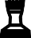



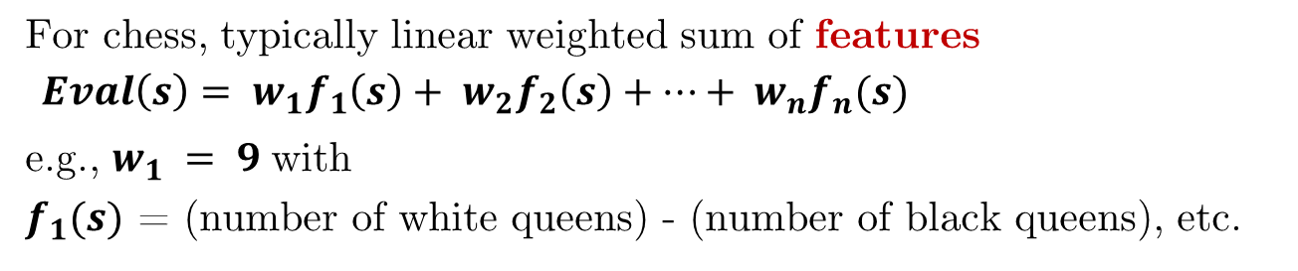
Evaluation functions
Black to move
White slightly better
White to move
Black winning
For chess, typically linear weighted sum of features
$Eval\left(s\right)= w_{1}f_{1}\left(s\right)+ w_{2}f_{2}\left(s\right)+…+ w_{n}f_{n}(s)$
e.g., $w_{1} = 9$with
$f_{1}(s)$ = (number of white queens) - (number of black queens), etc.

Slide 15
Digression: Exact values don't matter
MAX
MIN | 1 |  | 2 |  | 1 |  | 20
 | 1 | 2 | 2 | 4 | 1 | 20 | 20 | 400
Behaviour is preserved under any monotonic transformation of EVAL
Only the order matters:
payoff in deterministic games acts as an ordinal utility function

Slide 16
Deterministic games in practice
English Checkers: Chinook ended 40-year-reign of human world champion Marion Tinsley in 1994. Used an endgame database defining perfect play for all positions involving 10 or fewer pieces on the board, a total of 443,748,401,247 positions. Game was solved in 2007.
Chess: Deep Blue defeated human world champion Gary Kasparov in a six-game match in 1997. Deep Blue searches 200 million positions per second, uses very sophisticated evaluation, and methods for extending some lines of search up to 40 ply.
What about Go?

Slide 17
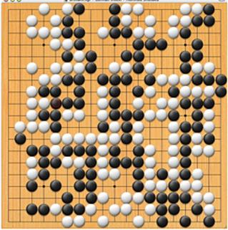
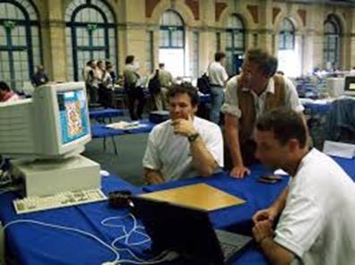
(Computer) Go
Vague concepts: Life and Death, Territory, Influence, Patterns
Hard to make implicit human knowledge explicit
No evaluation function, α-β search fails
Every AI trick was tried and failed miserably
Until 2005: 20 to 30 stones handicap was required
There has be something better than this…..

Slide 18
Monte Carlo Tree Search (MCTS)
Repeated X times
Selection
Play-out
Expansion
Backpropagation
The selection strategy is
applied recursively until an
unknown position is reached
One simulated
game is played
One node is added
to the tree
The result of this game is backpropagated in the tree
Coulom (2007) and Kocsis & Szepesvári (2006)
Build gradually a search tree
Best-first search
Very popular, very successful

Slide 19
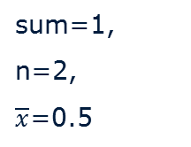
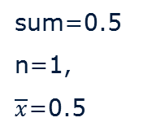
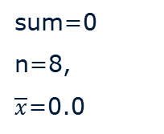
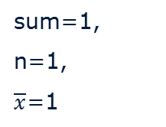
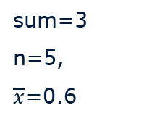
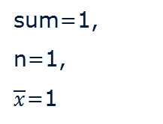
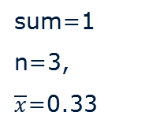
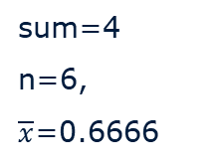
MCTS
R
sum=4
n=6,
$\overline{x}$=0.6666
sum=3
n=5,
$\overline{x}$=0.6
Z
sum=0
n=8,
$\overline{x}$=0.0
A
sum=1
n=3,
$\overline{x}$=0.33
sum=1,
n=2,
$\overline{x}$=0.5
B
sum=1,
n=1,
$\overline{x}$=1
C
?
sum=0.5
n=1,
$\overline{x}$=0.5
sum=0.5
n=1,
$\overline{x}$=0.5
D
E
sum=1,
n=1,
$\overline{x}$=1
F
Winning ratios
All players maximise the score from their perspective
Player 1 wins

Slide 20
Selection
Traversal from the root until we reach a position which is not part of the tree
Selection Policy: Controls exploitation and exploration balance
Upper Confidence bounds for Trees, UCT (Kocsis & Szepesvári, 2006)
Selects the child k of the node p according:
v_{i} is the value of the node i (average score so far),
n_{i} is the visit count of I
n_{p} is the visit count of p
C is a coefficient (0.4-0.8) to balance exploitation and exploration
Notes:
20

Slide 21
Play-out
Aka roll-out or simulation
Plays nearly-random moves (default)
Moves are played until the end of the game
Quite weak on its own
Uses heuristics
Bias the moves to good ones (play-out policy)
Early termination of the playout

Slide 22
Expansion
Standard: first node encountered in the play-out added to the tree
The tree grows progressively
Other expansion schemes possible to control memory consumption

Slide 23
Backpropagation
The result of a playout is backpropagated from the leaf node, through the previously traversed path (+1 win, 0.5 draw, 0 loss)
The value v of a node is computed by taking the average of the results of all simulated games made through this node

Slide 24
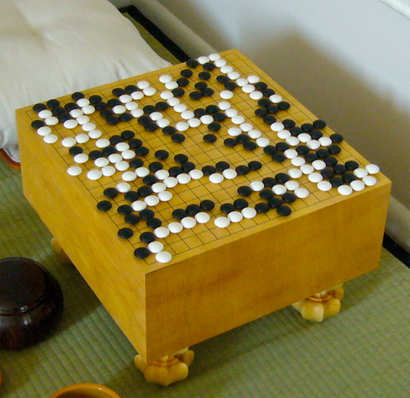
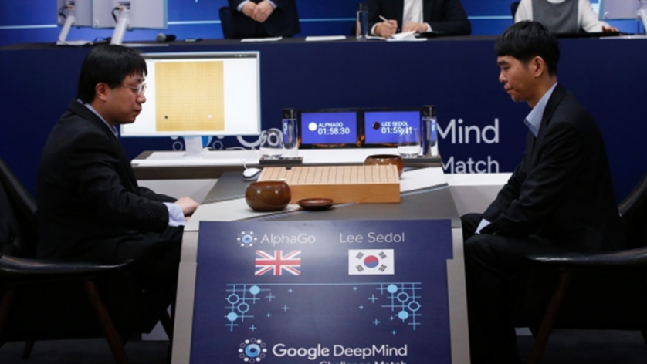
MCTS: Computer Go
AlphaGo defeated professional 9-dan human player Lee Sedol in 2016.
AlphaGo combines MCTS with deep neural networks

Slide 25
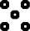
Games of chance: Backgammon
0 1 2 3 4 5 6 7 8 9 10 11 12
25 24 23 22 21 20 19 18 17 16 15 14 13

Slide 26
Resource limits
Chance introduced by dice, card-shuffling
Simplified example with coin-flipping:
MAX
3
CHANCE
3
−1
0.5
0.5
0.5
0.5
MIN
2
4
0
−2
2 4 7 4 6 0 5 −2

Slide 27
Algorithm for games of chance
EXPECTIMINIMAX (aka EXPECTIMAX) gives perfect play
Just like MINIMAX, except we must also handle chance nodes:
…
if state is a MAX node then
return the highest EXPECTIMINIMAX-VALUE of SUCCESSORS(state)
if state is a MIN node then
return the lowest EXPECTIMINIMAX-VALUE of SUCCESSORS(state)
if state is a chance node then
return average of EXPECTIMINIMAX-VALUE of SUCCESSORS(state)
…

Slide 28
Pruning in expectimax trees
A version of α-β pruning is possible (aka Star1):
≥1.5
[-∞,+∞]
[-∞, 0.5]
[1.5, 1.5]
[-∞,+∞]
[-∞, 2]
0.5
0.5
0.5
0.5
[-∞, 2]
[-∞,+∞]
[-∞, 0]
[-∞,+∞]
[-∞,+∞]
[1, 1]
[-∞,+∞]
[-∞, 1]
[-∞, 2]
[0, 0]
[2, 2]
X
2
2
2
1
0
1
1

Slide 29
Pruning in expectimax trees
More pruning occurs if we can bound the leaf values
For this example [-2,2]
≥1.5
[0, 2]
[-2,2]
[1.5, 1.5]
[-2,+2]
[-2, 1]
0.5
0.5
0.5
X
0.5
[-2,+2]
[-2,2]
[-2,2]
[-2,2]
[1, 1]
[-2, 0]
[2, 2]
X
2
2
2
1
0

Slide 30
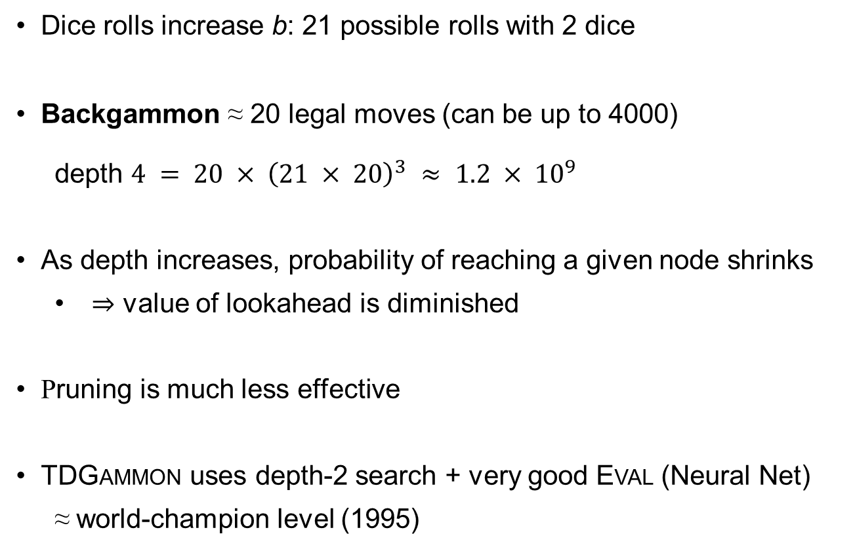
Games of chance in practice
Dice rolls increase b: 21 possible rolls with 2 dice
Backgammon ≈ 20 legal moves (can be up to 4000)
depth $4 = 20 × {\left(21 × 20\right)}^{3} ≈ 1.2 × {10}^{9}$
As depth increases, probability of reaching a given node shrinks
⇒ value of lookahead is diminished
Pruning is much less effective
TDGAMMON uses depth-2 search + very good EVAL (Neural Net)
≈ world-champion level (1995)

Slide 31
Digression: Exact values DO matter
MAX
CHANCE
2.1
1.3
21
40.9
.9
.1
.9
.1
.9
.1
.9
.1
MIN
2
3
1
4
20
30
1
400
2
2
3
3
1
1
4
4
20
20
30
30
1
1
400
400
Behaviour is preserved only by positive linear transformation of EVAL
Hence EVAL should be proportional to the expected payoff

Slide 32
Games of imperfect information
E.g., card games, where opponent's initial cards are unknown
Typically we can calculate a probability for each possible deal
Seems just like having one big dice roll at the beginning of the game*
Idea: compute the minimax value of each action in each deal, then choose the action with highest expected value over all deals*
Averaging over clairvoyance
AKA Determinisation
Special case: if an action is optimal for all deals, it's optimal.*
GIB, well-known and strong bridge program, approximates this idea by
1) generating 100 deals consistent with bidding information
2) picking the action that wins most tricks on average

Slide 33
Commonsense example
Road A leads to a small heap of gold pieces
Road B leads to a fork:
take the left fork and you'll find a mound of jewels;
take the right fork and you'll be run over by a bus.
Road A leads to a small heap of gold pieces
Road B leads to a fork:
take the left fork and you'll be run over by a bus;
take the right fork and you'll find a mound of jewels.
Road A leads to a small heap of gold pieces
Road B leads to a fork:
guess correctly and you'll find a mound of jewels;
guess incorrectly and you'll be run over by a bus.

Slide 34
Proper analysis
*Intuition that the value of an action is the average of its values in all actual states is WRONG
With partial observability, value of an action depends on the information state or belief state the agent is in
Can generate and search a tree of information states
Leads to rational behaviors such as
Acting to obtain information
Signaling to one's partner
Acting randomly to minimize information disclosure

Slide 35
Summary
Games are fun to work on! (and dangerous)
They illustrate several important points about AI
perfection is unattainable ⇒ must approximate
good idea to think about what to think about
uncertainty constrains the assignment of values to states
optimal decisions depend on information state, not real state
Games are to AI as grand prix racing is to automobile design
More about this in the Master AI Course Intelligent Search & Games

